Slide 1
EGC-211 L7: C++ classes: inheritance
T1-24-25
Ajay Bakre
Content Credit: Yashavant Kanetkar & Prof. Jaya Sreevalsan Nair

Slide 2
Inter-class Relationships in OO Design
Provide a way of interaction between objects of different classes
Types of inter-class relationships:
Composition: the object and its member have a strong part-whole relationship; characterized by “part-of” relationship, e.g. a kitchen is part of a house
Aggregation: a weaker form of composition, where the object and its member form a “has-a” relationship, e.g. library has shelves, books etc.
Association: a weaker form of aggregation, where the object forms a “uses-a” / “references-a” relationship with another object, e.g. student uses a car
Generalization / Specialization, where the object forms “is-a-kind-of” relationship with another object

Slide 3
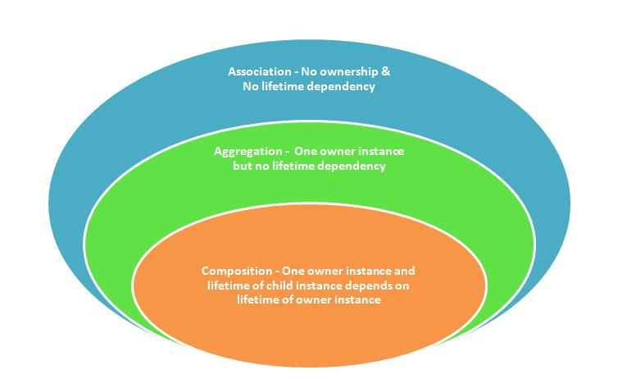
Composition vs. Aggregation vs. Association
// association
class Student {
Course* courses;
// ...
};
// aggregation
class Whole {
Part* part;
// ...
};
// composition
class Whole {
Part part;
// ...
};
Image courtesy: https://dotnetfreakblog.wordpress.com/2014/01/11/concept-of-dependency-generalization-association-aggregation-composition-in-object-oriented-programming/

Slide 4
Relationship Comparison
Property | Composition | Aggregation | Association
Relationship type | Whole/part | Whole/part | Otherwise unrelated
Members can belong to multiple classes | No | Yes | Yes
Members’ existence managed by class | Yes | No | No
Directionality | Unidirectional | Unidirectional | Unidirectional or bidirectional
Relationship verb | Part-of | Has-a | Uses-a
Image courtesy: https://www.learncpp.com/cpp-tutorial/10-4-association/

Slide 5
Initialization
Composition – Individual parts of the object are created during object initialization
e.g., real and imaginary parts of a complex number
Aggregation – An aggregate may be given the individual objects as parameters during initialization or it may start empty and objects are added later
e.g., initialize an array with elements or add elements later
Association – A link may be established between the associated objects as part of creation of one object or it may happen sometime later
e.g. create an association between an order and a customer
or create an association between a student and a course on enrollment

Slide 6
Inheritance
Captures the inter-class relationship of Generalization / Specialization
Inheritance in C++ allows a class being defined in terms of a pre-existing class
This produces a new class having all the functionality of the older class, and additionally defining its own specific functionality
Instead of composition, where a given class “contains” another class, we here introduce “derivation”, where a given class is-a(-type-of) or is-implemented-in-terms-of another class
The pre-existing class in an inheritance is called the base class, while the new class is called the derived class
A derived class “specializes” the pre-existing base class
A base class “generalizes” all of its derived classes

Slide 7
Inheritance in Real Life
Grandmother
Simple minded
Good English orator
Too religious
Mother
Simple minded <no-change>
Good English orator <no-change>
Moderately religious <change>
Good English writing skills <new>
Daughter
Simple minded <no-change>
Good English & Hindi orator <combination>
Not religious <change>
Plays competitive sport <new>

Slide 8
C++ Example
class Vehicle {
size_t _mass;
public:
// constructors/destructor
Vehicle();
Vehicle(size_t mass): _mass(mass);
~Vehicle();
// get/set functions
size_t mass() const;
void setMass(size_t mass);
};
class Land_Vehicle: public Vehicle {
size_t _speed;
public:
// constructors/destructor
Land_Vehicle();
Land_Vehicle(size_t mass, size_t speed) ;
// get/set functions
void setSpeed(size_t speed);
size_t speed() const;
};

Slide 9
Inheritance vs Composition
class Land_Vehicle: public Vehicle {
size_t _speed;
public:
// constructors/destructor //
Land_Vehicle();
Land_Vehicle(size_t mass, size_t speed) {
setMass(mass); // inherited member
_speed = speed;
}
// get/set functions //
void setSpeed(size_t speed) {_speed = speed;}
size_t speed() const {return _speed);
};
class Land_comp {
Vehicle d_v ; // composed Vehicle
size_t _speed ;
public:
// constructors/destructor //
Land_comp() ;
Land_comp(size_t mass, size_t speed) ;
~Land_comp() ;
// get/set functions //
void setMass(size_t mass) {
d_v.setMass(mass) ; // pass through
}
};

Slide 10
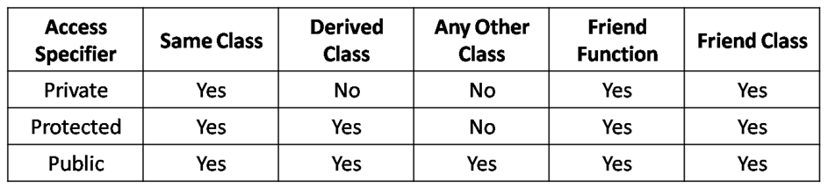
Access Control with Inheritance
Image Courtesy: http://www.startertutorials.com/blog/wp-content/uploads/2016/09/access-specifiers-in-cpp.png

Slide 11
Access Control Example
class Index {
private :
int count ;
public :
Index( ) {
count = 0;
}
void display( ) {
cout << count ;
}
void operator ++ ( ) {
count ++ ;
}
};
class Index1 : public Index {
public :
void operator --( ) {
count-- ;
// undeclared variable count
}
};

Slide 12
Access Control Example contd
class Index {
protected :
int count ;
public :
Index( ) {
count = 0;
}
void display( ) {
cout << count ;
}
void operator ++ ( ) {
count ++ ;
}
};
class Index1 : public Index {
public :
void operator --( ) {
count -- ; // OK now
}
};
int main( ) {
Index i;
i.display( ) ; // i == 0
++i ; // i.operator ++( )
i.display( ) ; // i == 1
--i ; // no such operator
i.display( ) ; // i == 0
}

Slide 13
Access Control Example contd
class Index {
protected :
int count ;
public :
Index( ) {
count = 0;
}
void display( ) {
cout << count ;
}
void operator ++ ( ) {
count ++ ;
}
};
class Index1 : public Index {
public :
void operator --( ) {
count -- ; // OK now
}
};
int main( ) {
Index1 i;
i.display( ) ; // i == 0
++i ; // i.operator ++( )
i.display( ) ; // i == 1
--i ; // OK now
i.display( ) ; // i == 0
}

Slide 14
Access Control and Encapsulation
A derived class does not have access to private members of the base class
The keyword private enables data hiding, and public enables communication with users
In a well-designed class, only its objects are in full control of their data
Private data members with public methods to access them
The keyword protected is used for members of the base class which are not in its public interface, but can be accessed by derived classes
Good practice:
If a derived class must have access to the private data of the base class, then use member functions (accessors and modifiers) which are declared protected in the interface of the base class
Maintain data integrity using encapsulation and data hiding
Encapsulation restricts access to functionality of objects
Data hiding restricts control over the data of an object exclusively to the members of its class

Slide 15
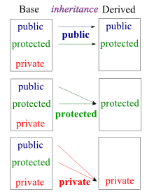
Modes of Inheritance
Public Inheritance
class Derived : public Base
No change in access control of Base class members in Derived class
Protected Inheritance
class Derived : protected Base
Public and protected members of Base class become protected in Derived class
Private Inheritance
class Derived : private Base
All members of Base class become private members in Derived class
Image courtesy: https://www.bogotobogo.com/cplusplus/multipleinheritance.php

Slide 16
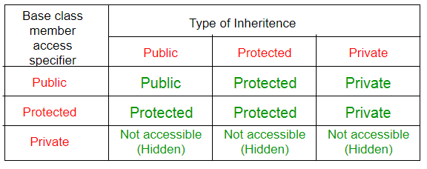
Summary of Inheritance in C++
Image courtesy: https://eng.libretexts.org/Courses/Delta_College/C_-_Data_Structures/04%3A_Inheritence/4.04%3A_Modes_of_Inheritance

Slide 17
Which Mode of Inheritance to Use?
Private inheritance is the default mode of inheritance
Needed in situations where a derived class object is defined “in-terms-of” the base class, but where composition cannot be used.
Public inheritance should be used to define an is-a relationship between a derived class and a base class (most commonly used)
A derived class object “is-a” base class object allowing the derived class object to be used polymorphically as a base class object in code that expects it
Protected inheritance is not widely used
May be useful when defining a base class that is itself a derived class and needs to make its base class members available to classes derived from itself

